Slide 1

My Algebra Interactive Notebook
Name
Class
Teacher
Semester 2
Term 3
1

Slide 2

Interactive Notebooks!
Cover Page
Contents Page
Glossary
24/7/30
EQ
Questions
Notes
Summaries
Work page
Presentation!!!
Your book, your responsibility!

Slide 3
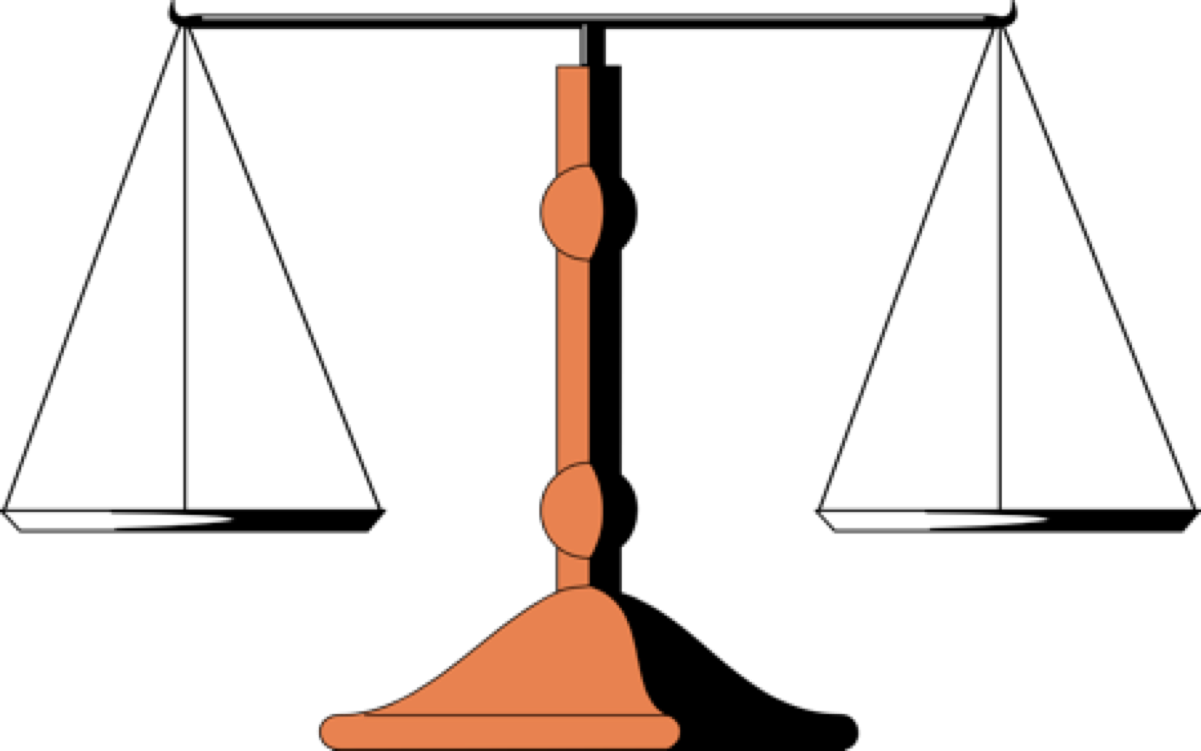
An Equation is like a balance scale. Everything must be equal on both sides.
=
20
2x +5

Slide 4
What you do to one side of an equation, you must do to the other side to keep it balanced!
=
20
2x +5
-5
-5

Slide 5
What you do to one side of an equation, you must do to the other side to keep it balanced!
=
15
2x
__
2
__
2

Slide 6
What you do to one side of an equation, you must do to the other side to keep it balanced!
=
7.5
x

Slide 7
Try to solve this subtraction equation
How do you get n all by itself?
=
18
n - 3
+3
+3

Slide 8
Try to solve this subtraction equation
How do you get n all by itself?
=
21
n

Slide 9
Show your check by substituting your answer back into the original equation.
=
18
21
n - 3

Slide 10
24
7
30
Solving Two-Step Algebraic Equations
Date
EQ – What are the steps involved in solving two-step algebraic equations?
Solving Two-Step
Equations
To solve any equation, you want to get the variable all by itself. You get the variable alone by using inverse operations.
Inverse Operations are like Opposites.
Summary:

Slide 11
24
7
30
Solving Two-Step Algebraic Equations
Date
EQ – What are the steps involved in solving two-step algebraic equations?
you have to do exactly
When you do something
Solving Two-Step
Equations
to one side of an equation,
the same thing
to the other side.

Slide 12
24
7
30
Solving Two-Step Algebraic Equations
Date
EQ – What are the steps involved in solving two-step algebraic equations?
1) Undo the addition or subtraction operation first, by using inverse operations.
Solving Two-Step
Equations
2) Undo the multiplication or division operation second, by using inverse operations.

Slide 13
24
7
30
Solving Two-Step Algebraic Equations
Date
EQ – What are the steps involved in solving two-step algebraic equations?
Solve: 3x + 4 = 16
Solving Two-Step
Equations
3x + 4 = 16
-4 -4
Undo Addition or Subtraction 1st
3x = 12
3
3
Undo Multiplication or Division 2nd
x = 4

Slide 14
24
7
30
Solving Two-Step Algebraic Equations
Date
EQ – What are the steps involved in solving two-step algebraic equations?
1) GOAL:
Get the variable on one side
of the equation.
To Review
2) You always perform the same operation to
both sides of an equation.
3) To undo an operation you perform its opposite operation to both sides of the equation.
4) It is easier if you undo addition or subtraction before you undo multiplication or division.

Slide 15
24
7
30
Solving Two-Step Algebraic Equations
Date
EQ – What are the steps involved in solving two-step algebraic equations?
Example 1
2x + 4 = 10
Get the variable alone.
- 4 - 4
2x = 6
__ __ 2 2
+4 and -4 cancel out
Divide both sides by 2
x = 3
2 divided by 2 cancel to 1
2(3) +4 = 10
Show your check.
6 + 4 = 10
10 = 10
Finish your check.

Slide 16
24
7
30
Solving Two-Step Algebraic Equations
Date
EQ – What are the steps involved in solving two-step algebraic equations?
3m - 10 = 17
Get the variable alone.
Example 2
+ 10 +10
Add 10 to both sides.
3m = 27
__ __ 3 3
+10 and -10 cancel out
Divide both sides by 3
m = 9
3 divided by 3 cancel to 1
3(9) – 10 = 17
Show your check.
27 – 10 = 17
Finish your check.
17 = 17

Slide 17
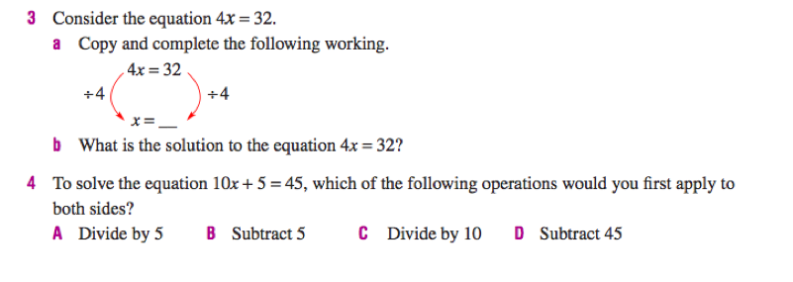
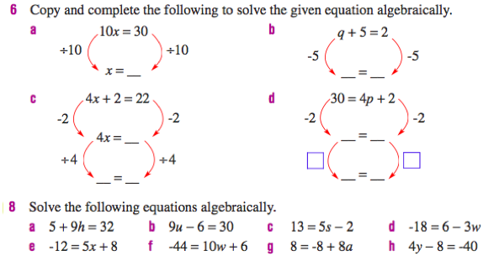

Slide 18
24
7
30
Solving Two-Step Algebraic Equations
Date
EQ – What are the steps involved in solving two-step algebraic equations?
Don’t forget!!!
Summary:

Slide 19
Notes Review
24, 7 ,30
Date
Title
Essential question
Notes complete
Notes complete with colour and diagrams
Questions completed
Contents page filed in
Formula page filled in

